Slide 1

Bird Strikes Between 2000-2011 Analysis

Slide 2
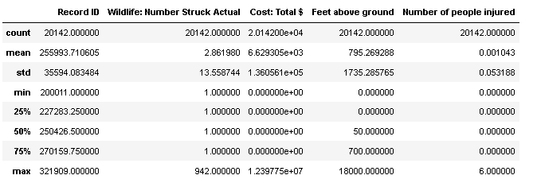
Describe of Bird Strikes Between 2000-2011

Slide 3
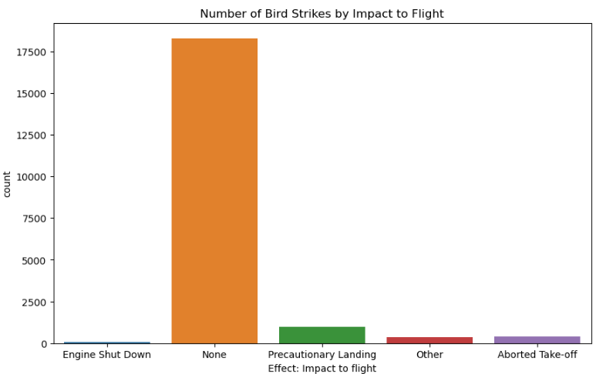
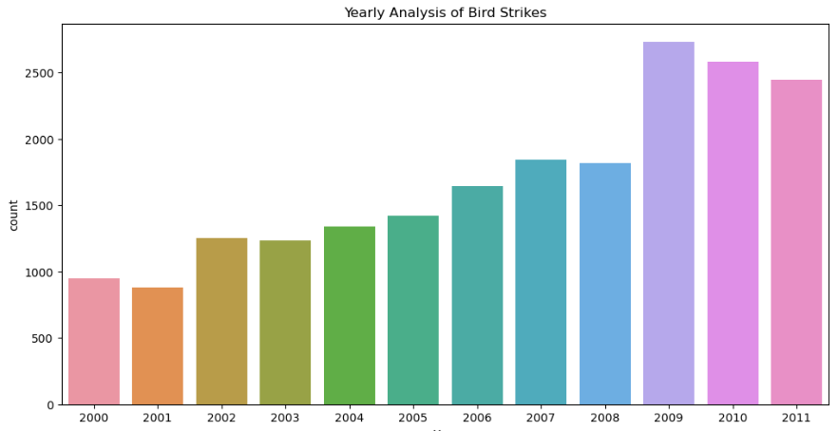
Visualization

Slide 4
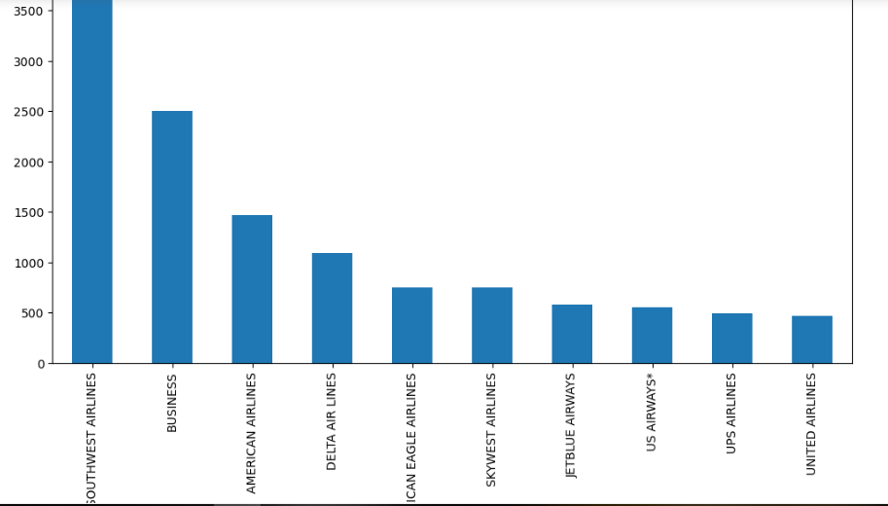
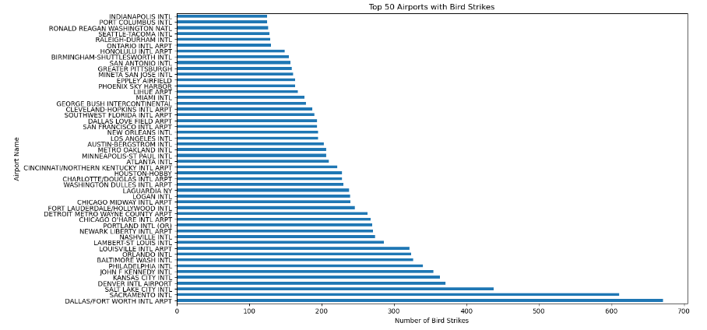
Top Airlines and Top Airports with Bird Strikes
Top 10 Airlines with Bird Strikes

Slide 5
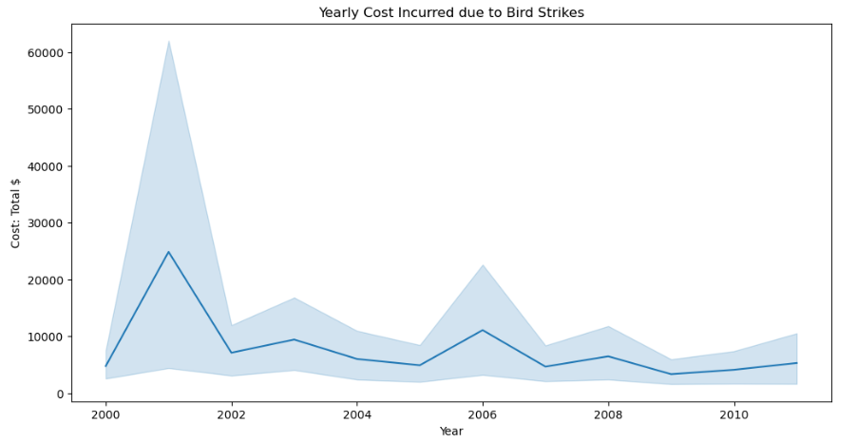
Yearly Cost Representing

Slide 6
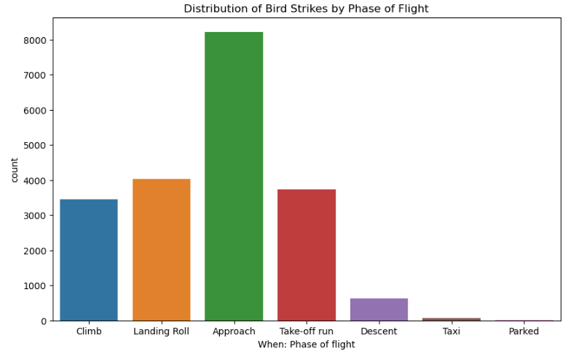
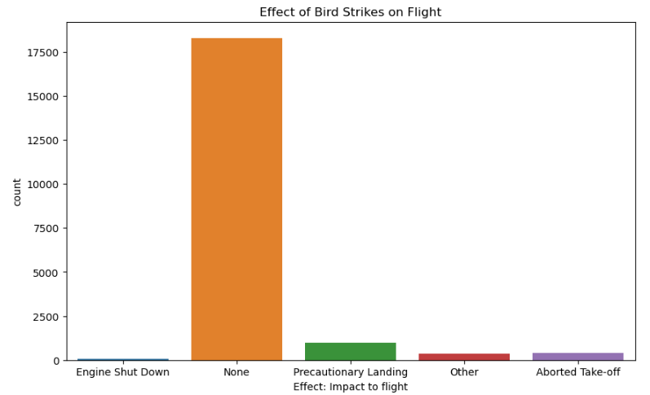
Distribution & Effect of Bird Strikes on Flight

Slide 7
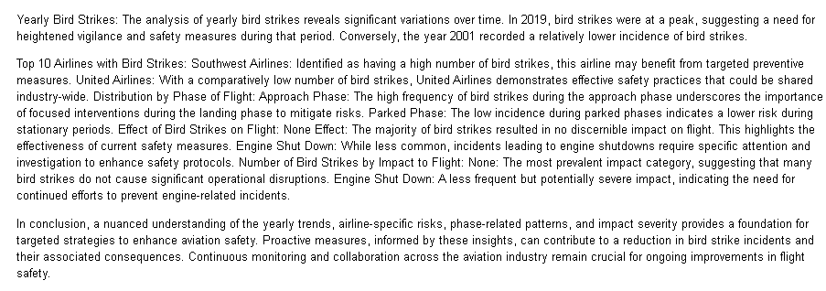
Conclusion

Slide 8
Thank You

